Slide 1
DMIT 1530
Week 5
Responsive Background Images

Slide 2
We can serve our users different images
based upon what size their viewport is.

Slide 3
If a user is accessing our site from a mobile device, there’s no need to serve them a massive image.
Conversely, if they’re accessing our site from a desktop device, we shouldn’t give them an image that’s overly compressed.

Slide 4
We can do this easily by preparing different versions of a background image and popping them into media queries.

Slide 5
While we can do this by changing the dimensions of an image or the settings when we save a file from Photoshop, Squoosh makes it easy.

Slide 6
We’ll do this in our demo today, as well as take an introductory glance at the background property.

Slide 7
background Property
… for when you gaze long into the abyss,
the abyss gazes also into you.

Slide 8
Sometimes, you just can’t
memorise everything.

Slide 9
This is the case with the background property.
Because it’s a combination of several other properties, the formal syntax looks like the
visual equivalent of a migraine.
Notes:
The background property is a shorthand property for: background-attachment, background-clip, background-color, background-image, background-origin, background-position, background-repeat, background-size

Slide 10
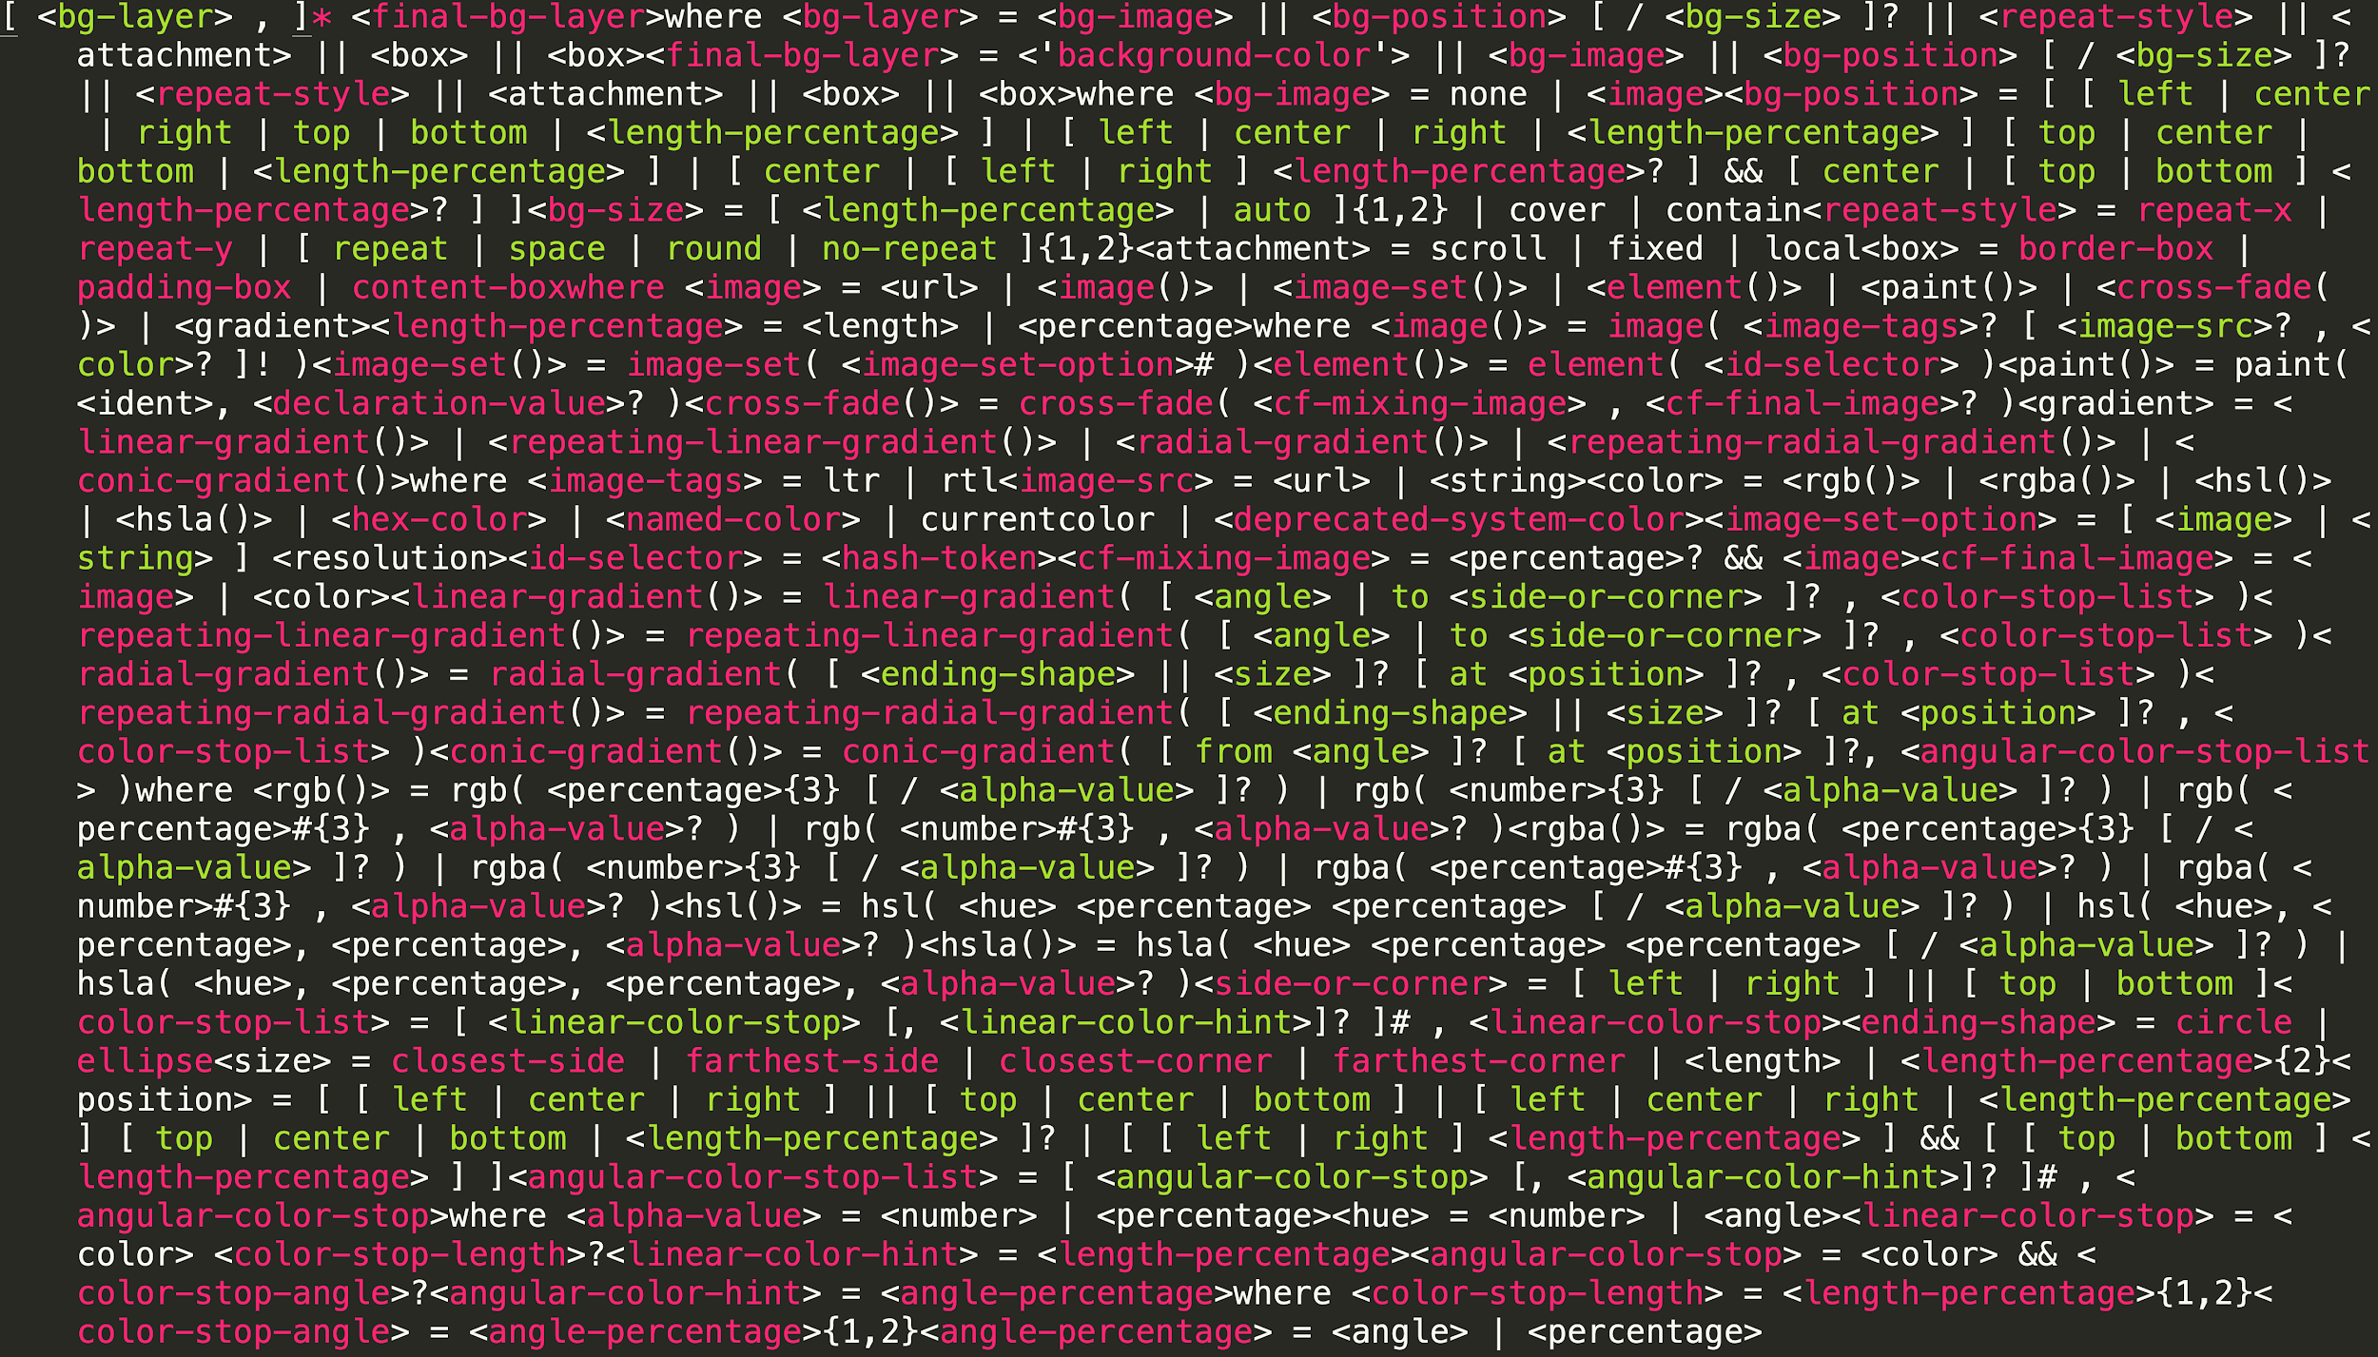

Slide 11
Because there are so many possible combinations and values that we can use with the background property, we’re going to narrow in on just a couple of examples.

Slide 12
You can use background to specify a simple colour.

Slide 13
background-color
background: chartreuse;

Slide 15
You can also stack an image on top of a colour.
This colour will only appear if the image does not cover the entire container.

Slide 16
background-image
background-repeat
background: #f0f url(../img/bg.jpg) repeat-x;
background-color
note: color renders underneath background-image

Slide 17


Slide 18
You can also specify things like how large the background image should be* and how it should be positioned within the container**.
* in our example, it’s stretched to cover the entire container
** in our example, the image is centred within the container

Slide 19
background-image
background-size
background: url(../img/bg.jpg) center / cover no-repeat;
background-position
background-repeat

Slide 21
Further Reading
CodePen: Background Recipes
codepen.io/webinspect/pen/emBzRd
web.dev: Optimize CSS background images with media queries
web.dev/optimize-css-background-images-with-media-queries/

